Slide 1

BY PEACE NGOZI AGHEDO

Slide 2
1. Customer Journey Based Marketing Plan

Slide 3
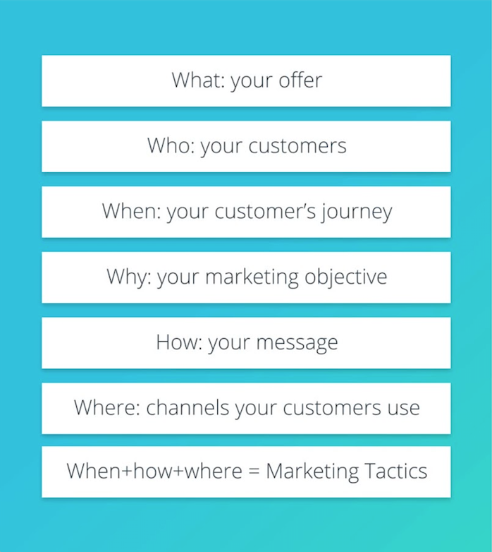
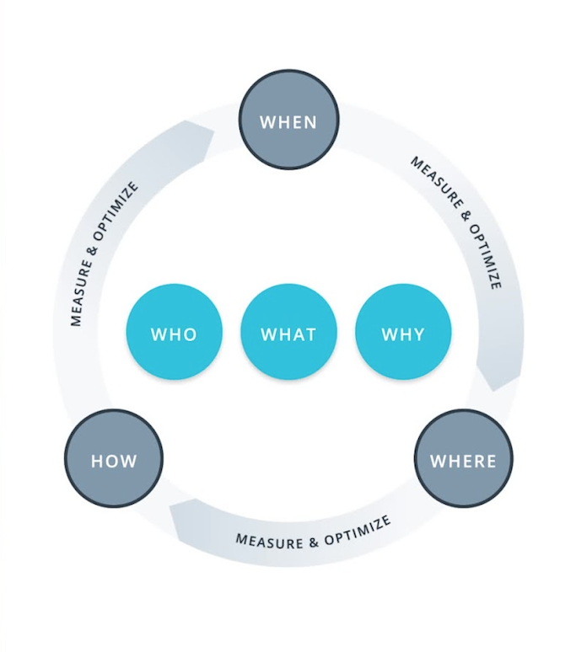

Slide 4
What: Your Offer

Slide 5
Digital Marketing Nanodegree Program
Create a Customer Journey Based Marketing Plan with the goal of signing up new customers to the DMND Program in one quarter.
Budget: $50,000
Profit: For the purpose of this assignment, the cost of the Nanodegree is $999, assume a profit margin of 30%, meaning that Udacity makes $299 in profit per student that signs up.
Campaigns: We want to aggressively grow the program, but, we want to do it without losing money.

Slide 6
Marketing Objective:
Your Company’s Product/Service
To enroll 200 students within 3 months with a total budget of $50,000.
KPI: The number of students enrolled.

Slide 7
Who Are Our Customers?

Slide 9
VALUE PROPOSITION
FOR Individuals interested in acquiring Digital Marketing skills.
WHO Need a 360 degree knowledge and certification in Digital Marketing.
OUR Digital Marketing Nanodegree Program.
THAT Offers comprehensive content anchored by industry experts.
UNLIKE Marketing Course in Udemy
OUR OFFER Includes a 360 degree knowledge accompanied with comprehensive industry led practical in Digital Marketing that provides learners the capacity to freelance or get hired by top companies in the world.

Slide 10
Target Persona
Background and Demographics | Target Persona Name | Needs
AGE: 40 GENDER: Male MARITAL STATUS: Married NUMBER OF CHILDREN: 3 COUNTRY: Nigeria STATE OF RESIDENCE: Edo EMPLOYED: Yes ANNUAL INCOME: 1 million naira HIGHEST CERTIFICATION: Masters Degree | MATTHEW | Sufficient internet network. Projects to practice Digital Marketing. Better work and better cash inflow. Tutorial videos
Hobbies | Goals | Barriers
Play FIFA PES Travel Singing Dancing Chess | A better job Does not see self in this same industry in the next 3 years. Sees self as a high profiled Digital Marketer in the next 3 years. | High cost of data poor Internet Financial constraints Too many responsibilities at work.

Slide 12
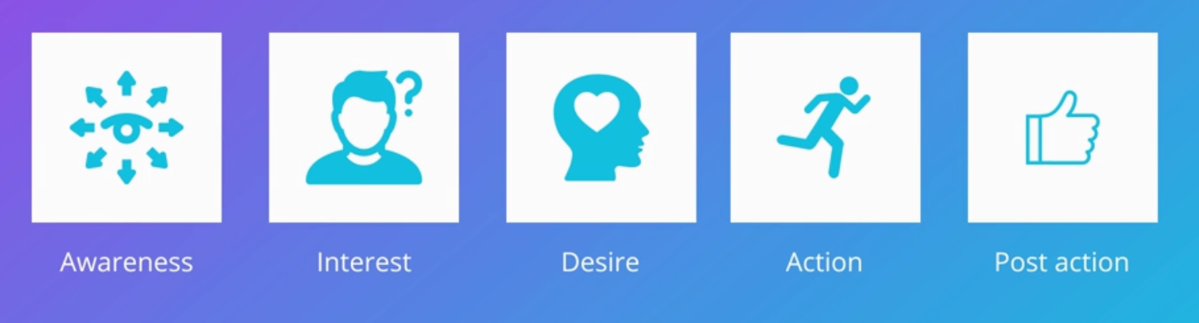
Phases of the Customer Journey

Slide 13
When+How+Where = Marketing Tactics
Customer Journey | Awareness | Intent | Desire | Action | Post Action
Message | Describe growth in demand for digital marketers as the world is going digital. Gain new marketing skills at your own pace Describe how much of a lucrative career digital marketing is. | Claim your free eBook now. Explain how one can get a 360 degree knowledge of digital marketing from the Udacity nanodegree. | Call to action: Enroll now and start running live campaigns on top marketing platforms. Using online webinar, explain the benefits of the digital marketing program | Take sudents to landing page to sign up Thank you! | Career support services updates Notifications to subscribe to email for further offers and promotional contents Classroom updates News about digital marketing
Channel | Use display ads and video ads Social media platforms my target persona visits | Search Google ads Social media advertising | Use of email marketing Use of search | Email marketing Social media advertising | Email Social media

Slide 14
2. Budget Allocation

Slide 15
DMND
Budget Allocation

Slide 16
Awareness: Budget Allocation for Media
Channels | Planned Spend | Cost Per Click | Number of Site Visits | Average Conversion Rate | Total Sales
Facebook | $5,000 | $1.25 | 400 | 0.05% | 2
AdWords Search | $3,000 | $1.40 | 2143 | 0.05% | 1
Display | $2,000 | $5.00 | 400 | 0.05% | 0
Video | $2,500 | $3.50 | 714 | 0.05% | 0
Total Spend | $12,500 | Total # Visitors | 7257 | Number of new Students | 3

Slide 17
Interest: Budget Allocation for Media
Channels | Planned Spend | Cost Per Click | Number of Site Visits | Average Conversion Rate | Total Sales
Facebook | $5,000 | $0.50 | 10000 | 0.1% | 10
AdWords Search | $3,000 | $1.50 | 2000 | 0.1% | 2
Display | $2,000 | $3.00 | 667 | 0.1% | 1
Video | $2,500 | $2.75 | 909 | 0.1% | 1
Total Spend | $12,500 | Total # Visitors | 13576 | Number of new Students | 14

Slide 18
Desire: Budget Allocation for Media
Channels | Planned Spend | Cost Per Click | Number of Site Visits | Average Conversion Rate | Total Sales
Facebook | $18,000 | $0.30 | 60,000 | 0.3% | 180
AdWords Search | $4,000 | $1.50 | 2,667 | 0.3% | 8
Display | $1,500 | $3.00 | 500 | 0.3% | 2
Video | $1,500 | $2.75 | 545 | 0.3% | 2
Total Spend | $25,000 | Total # Visitors | 63,712 | Number of new Students | 192

Slide 19
ROI: Budget Allocation for Media
Phase | Total Spend | Total Number of Site Visits | Total Number of Sales | Profit Per Sale | Total Profit | ROI
Aware- ness | $12,500 | 7257 | 3 | $299 | $897 | -$11,603
Interest | $12,500 | 13576 | 14 | $299 | $4,186 | -$8,314
Desire | $25,000 | 63712 | 192 | $299 | $57,408 | +$32,408
Total | $50,000 | 84545 | 209 |  | $62,491 | +$12,491

Slide 20
Additional Channels or Recommendations:
Using an SEO driven content plan, organic reach can be grown through search and social media. It will also include blogposts (testimonials) written be graduates of the program and expert’s guide/advice on career change.
I’ll add “free eBook” and “free online courses” to the landing page to captivate the interest of visitors to signup for future email marketing campaigns.
Using LinkedIn and Facebook we can calculate which channel performed better based on the ROI. I will use my targe5 persona and others like entrepreneurs, front wed developers and copywriters. Emails collected from both Channel can later be use for remarketing to get better results.

Slide 21
3. Showcase Work

Slide 22
BY PEACE AGHEDO

Slide 23
Marketing Objective
To get 60 new readers for my blog post() withing 4 months (of publishing the artice) without spending 1 naira for ads.

Slide 24
KPI
The primary KPI to measure the marketing success would be the number of new readers i get for my blog().

Slide 26
What is the theme and framework of your blog post?
Provide a brief summary of your blog post including the following:
Select a theme for your blog post:
I Choose “Why have you decided to take the Digital Marketing Nanodegree Program?
2. What is the framework of your blog post?
I will use: SCQA also called the Pyramid Principle

Slide 27
BLOG POST

Slide 28
SUMMARY
Choose three social media platforms you will use to promote your blog.Write a short explanation about why you chose those platforms.
i will promote my blog on the following 3 social media platforms because these are the main social media networks the target persona hangs out primarily.
LinkedIn: it is a professional network where personal information and ideas are shared. since my blog post is about jobs, skills and personal experiences, it will be an excellent content for LinkedIn users. I used avery sober, professional tone for my LinkedIn post.
Twitter: This platform is also great for disseminating information. it is used by recruiters and brands across the world. I used a short note for twitter to keep the character limit constraints.
Facebook: this is most used by my target persona. it is a global platform for exchanging news and information, both professional and personal. I used a semi-personal tone for my Facebook.

Slide 29
PLATFORM 1 AND POST
LINKEDIN POST

Slide 30
PLATFORM 2 AND POST
TWITTER POST

Slide 31
PLATFORM 3 AND POST
FACEBOOK POST

Slide 32


BY PEACE AGHEDO

Slide 33
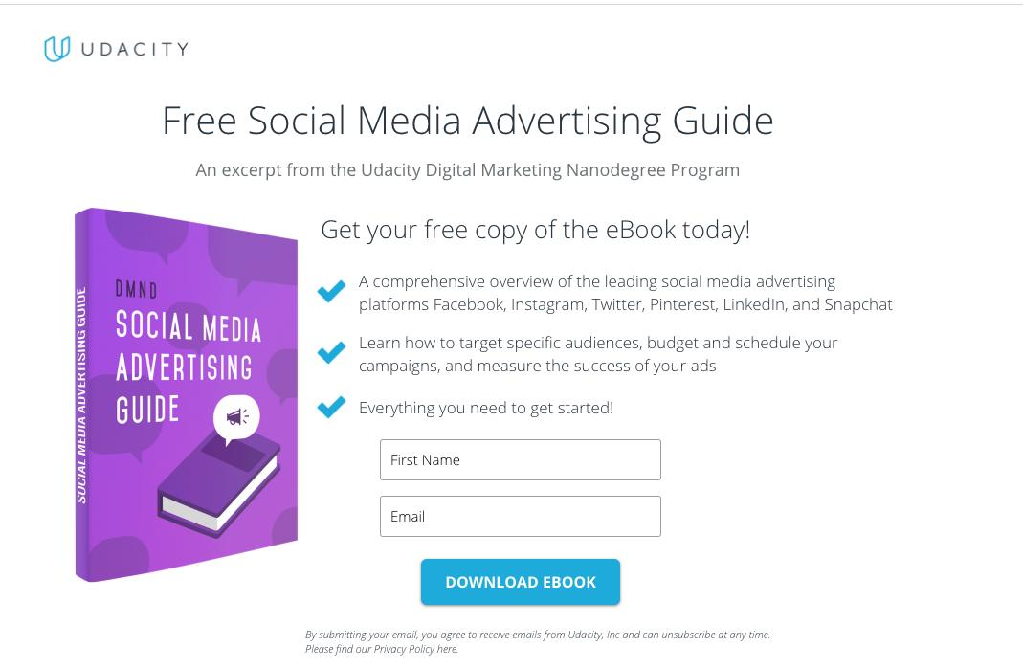
Landing Page

Slide 34
Marketing Objective & KPIs
Marketing Objective: To collect the email addresses of 50 potential students for the Digital Marketing Nanodegree Program, with a campaign running for one week and having a lifetime budget of $1000
KPI: Number of eBook downloads

Slide 35
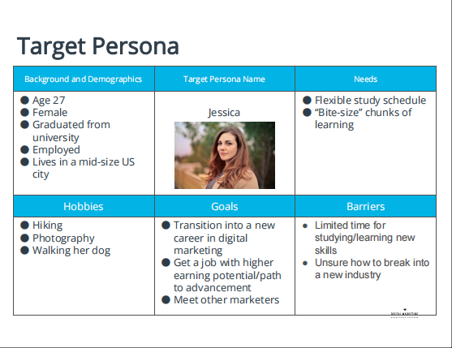

Slide 36
Ad Set
The following three ads are the Ad Set we have designed to target that persona on the previous slide.

Slide 37
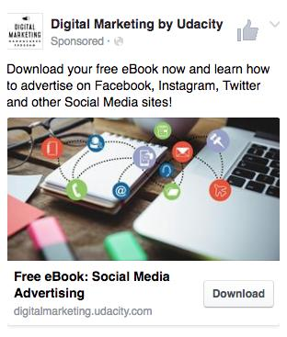
Ad One

Slide 38
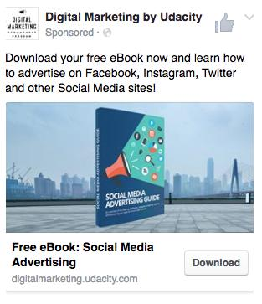
Ad Two

Slide 39
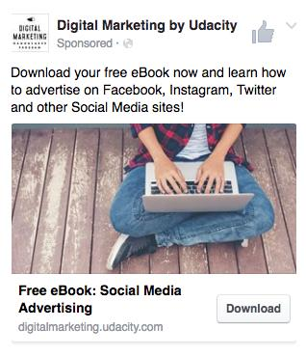
Ad Three

Slide 40
Campaign Evaluation

Slide 41
Campaign Evaluation
Evaluate the success of the campaign, given its marketing objective. Feel free to use bullet points, and add as many slides as you need.
a. Briefly describe the targeting of the ad set (demographics, location, interest, behavior etc.)
b. Provide the correct formulas for the following KPIs:
i. CPM (Cost per 1,000 Impressions)
ii. Link Click-Through Rate
iii. CPLC (cost per link click)
iv. Click To Lead Rate
v. Cost per Results
c. Based on the “Key Results” table, identify which ad performed best, and explain why you think this was the case.
d. How would you optimize the campaign, and explain why do you think so?
e. Write up a high-level overview of how well or not well the campaign performed, based on the marketing objective.

Slide 42
AD SET TARGETING
DEMOGRAPHICS:-
AGE: 18 to 50 years
GENDER: All gender
OCCUPATION: EMPLOYED
EDUCATION: B.Sc graduates
LANGUAGE: English language
LOCATION:- Mid-size US
INTEREST:- Hiking, Walking Dogs, Meeting fellow marketers.
BEHAVIOR:- A job with a higher income

Slide 43
KPI FORMULAS
i. CPM (Cost Per 1000 Impression)= Total Cost x
1000/ impression
ii. Link Click-Through Rate= No of clicks/
impression x 100
iii. CPLC (Cost Per Link Click)= Total cost/ no of
clicks
iv. Click To Lead Rate= lead / clicks x 100
v. Cost Per Results= Total lead cost / total result

Slide 44
THE BEST AD
Ad Two (media guide book) is the best Ad of all 3.
The Facebook platform shows that it has the highest number of impressions amongst them all.
Indeed, the amount spent to run the ad was higher than all others, hence it yielded a better result.
Ad two has the largest leads.
Click to lead rate is the highest.
Cost per result was the lowest, $13.25. Recall the formula-
Cost Per Results= Total lead cost / total result. The amount
spent to run Ad two was higher - $566.09 and it had a higher
number of total result(lead)- 43. Hence the total Cost per result is lower than that of others.

Slide 45
CAMPAIGN OPTIMIZATION
Judging from the campaign result, Ad 3 had a lower Click Through Rate (CTR)- 19% as compared to Ad 1- 24% and Ad 2- 29%. Hence the need the optimize Ad 3 in order to achieve the campaign objectives. To optimize this campaign, i will create another Ad Variation to match against Ad 2. This other Ad copy will have same image as Ad 2. The copy’s call to action will be tagged “sign up for free ebook”. The aim of this test is to ascertain how the image used affects the objectives of the campaign. Initially, different pictures were used in the 3 Ads. It is assumed that, Ad 2 had more Click Through Rate (CTR) because an image of a book was used which gives them a glimpse of the real book (pdf) they will get once they sign up

Slide 46
CAMPAIGN RECOMMENDATION
I would rather use a Ad copy that says, “ Get a free eBook that will assist you in your social media advertisement journey”.
2. My focus will be on unemployed people and new university graduates.
3. I will change the “submit” button to “Download eBook”

Slide 47
CAMPAIGN OVERVIEW
Marketing objectives were achieved and exceeded.
The campaign’s goal of collecting email addresses of 50 potential students within 1 week and with the budget of $1000 was achieved.
Ad one yielded 13 leads.
Ad two yielded 43 leads.
Ad three yielded 10 leads.
Total leads from all 3 Ads- 13+43+10 = 63leads.
Hence, the campaign yielded more than 50 leads.

Slide 48
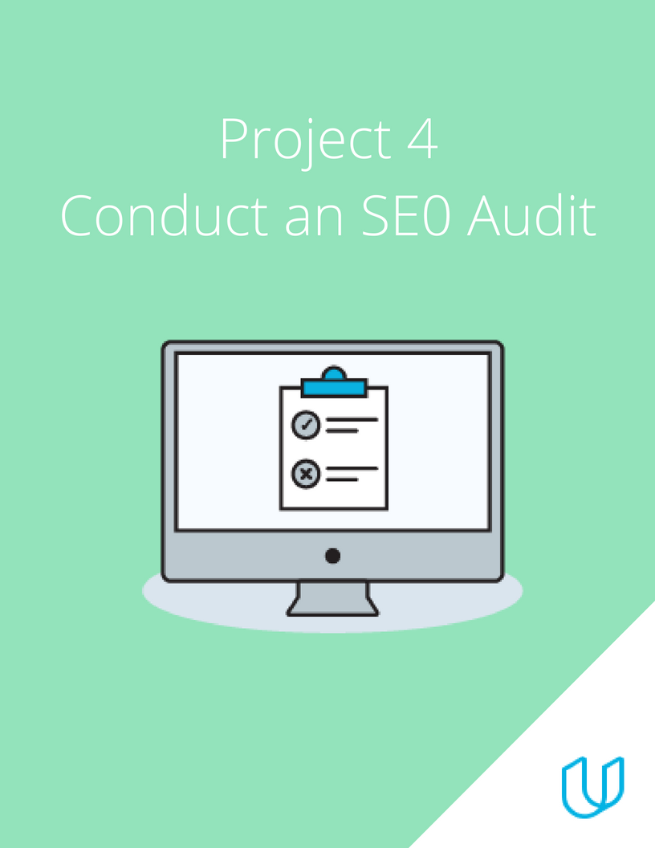
BY PEACE AGHEDO

Slide 49
Part 1
Plan your Audit

Slide 50
Marketing Objective & KPI
Marketing Objective – To increase organic search traffic by 20 percent by September 2022
KPI – click through rate by September 2022

Slide 51
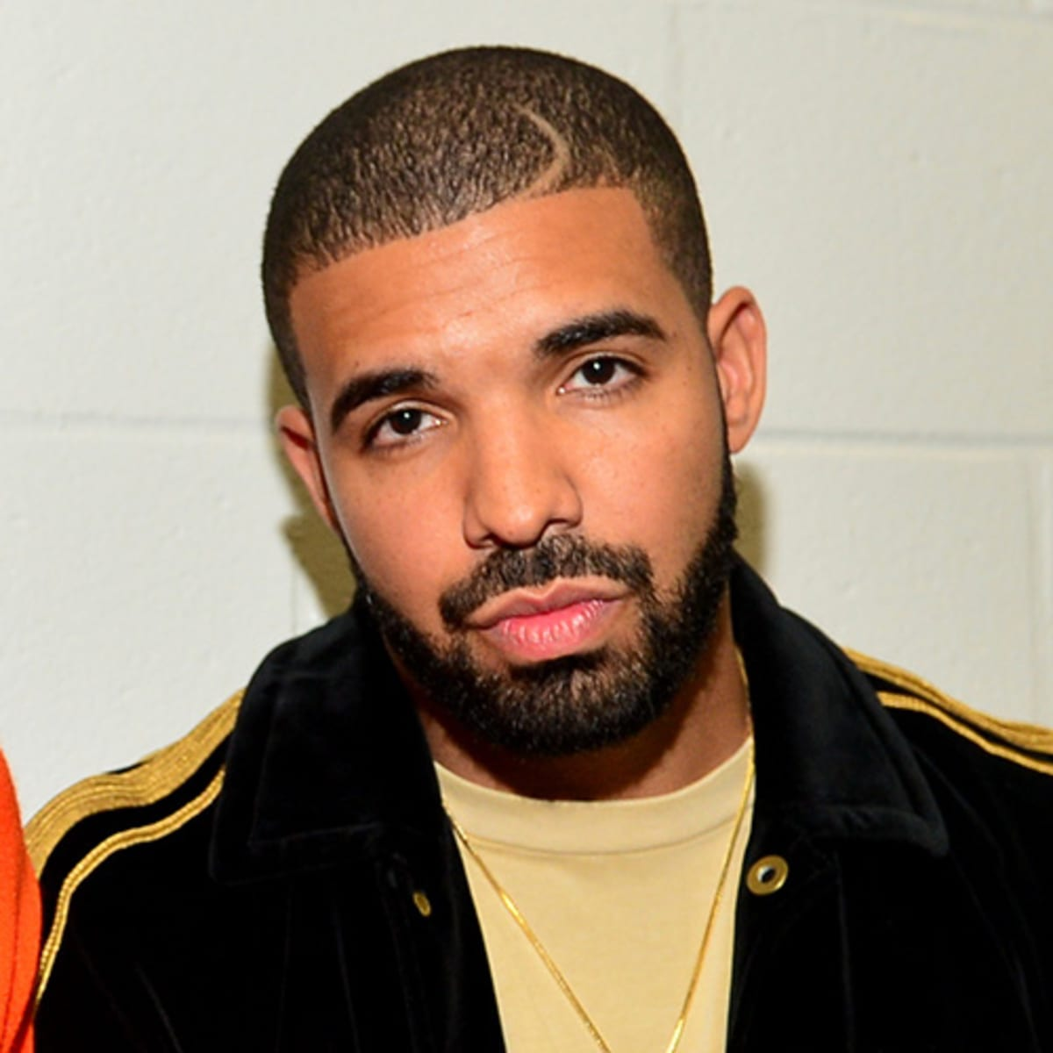
Target Persona
Background and Demographics | Target Persona Name | Needs
AGE: 40 GENDER: Male MARITAL STATUS: Married NUMBER OF CHILDREN: 3 COUNTRY: Nigeria STATE OF RESIDENCE: Edo EMPLOYED: Yes ANNUAL INCOME: 1 million naira HIGHEST CERTIFICATION: Masters Degree | MATTHEW | Sufficient internet network. Projects to practice Digital Marketing. Better work and better cash inflow. Tutorial videos
Hobbies | Goals | Barriers
Play FIFA PES Travel Singing Dancing Chess | A better job Does not see self in this same industry in the next 3 years. Sees self as a high profiled Digital Marketer in the next 3 years. | High cost of data poor Internet Financial constraints Too many responsibilities at work.

Slide 52
Part 2
On Site SEO
Audit

Slide 53
Keywords
Using Moz Keyword Explorer tool, identify the Keywords you might target to drive users to this page. Be sure to use a mix of branded and non-branded Keywords. List 5 head and 5 tail keywords.
 | Head Keywords | Tail Keywords
1 | Digital marketing | Digital marketing certificate
2 | Marketing courses | Digital marketing course
3 | nanodegree | Digital marketing courses
4 | Udacity | Digital marketing jobs
5 | Udacity scholarships | Digital marketing salary

Slide 54
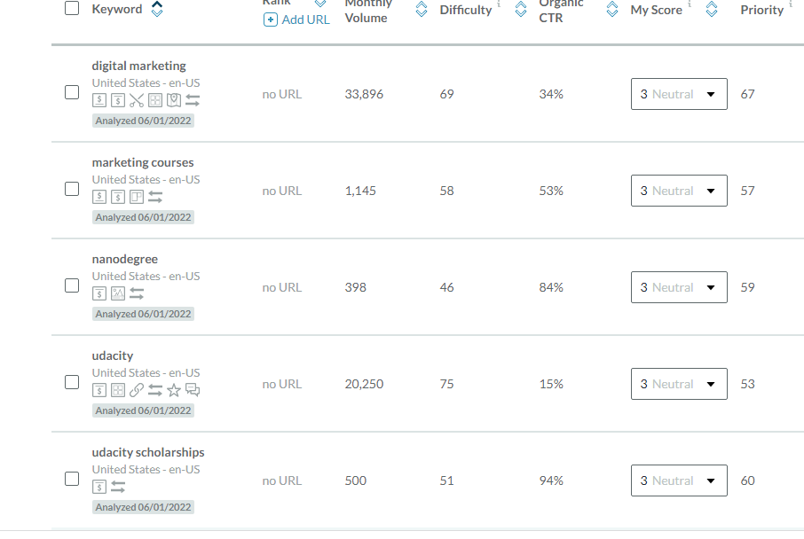
Head screenshot

Slide 55
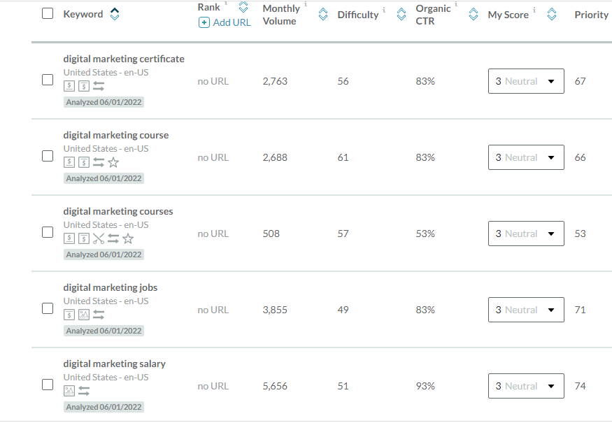
Tail screenshot

Slide 56
Keyword with the Greatest Potential
Head Keyword with the greatest potential?
From my keyword query, the keyword “Digital marketing” has the greatest potential because it has a monthly search volume of 33,896, difficulty of 69 and high click through rate of 34%
Tail Keyword with the greatest potential?
From my keyword query, the keyword “Digital marketing Salary” has the greatest potential because it has a monthly search volume of 5656, low difficulty of 51 and high click through rate of 93%.

Slide 57
Technical Audit: Metadata
url: view-source:https://www.udacity.com/course/digital-marketing-nanodegree--nd018
Current
Title Tag | Digital Marketing Course Online
Meta- Description | Take Udacity digital marketing course online. You will learn SEO, SEM, Google Ads, Email Marketing and Affiliate tactics to maximize traffic and improve online visibility
Alt-Tag 1 | img class="wordmark_logo__2xZEi" src="/images/svgs/udacity-tt-logo.svg" alt="Udacity
Alt-Tag 2 | img src="/images/brand-refresh/mobile-open.svg" alt=""
Alt-Tag 3 | img class="_consumer-schools_schoolIcon__25KX1" src="/images/brand-refresh/school-icons/ai.svg“alt=""
Alt-Tag 4 | img class="_consumer-schools_schoolIcon__25KX1" src="/images/brand-refresh/school-icons/autonomous-systems.svg" alt=""
Alt-Tag 5 | <img class="_consumer-schools_schoolIcon__25KX1" src="/images/brand-refresh/school-icons/cloud-computing.svg" alt=""

Slide 58
url: view-source:https://www.udacity.com/course/digital-marketing-nanodegree--nd018
Revision
Title Tag | Online Digital Marketing Course
Meta- Description | Udacity digital marketing online course will teach you SEO, SEM, Google Ads, Email Marketing and Affiliate tactics to maximize traffic and improve online visibility
Alt-Tag 1 | img class="wordmark_logo__2xZEi" src="/images/svgs/udacity-tt-logo.svg" alt=“logo”
Alt-Tag 2 | img src="/images/brand-refresh/mobile-open.svg" alt=“ open icon"
Alt-Tag 3 | img class="_consumer-schools_schoolIcon__25KX1" src="/images/brand-refresh/school-icons/ai.svg“alt=“ ai"
Alt-Tag 4 | img class="_consumer-schools_schoolIcon__25KX1" src="/images/brand-refresh/school-icons/autonomous-systems.svg" alt=“ autonomous icon"
Alt-Tag 5 | <img class="_consumer-schools_schoolIcon__25KX1" src="/images/brand-refresh/school-icons/cloud-computing.svg" alt=“ cloud icon"

Slide 59
Suggested Blog Topics
Write three Blog topics that incorporate the highest potential Keywords. Include a short summary (150 - 300 words max for each post) as to why you chose those Keyword topics and what you might write about.
Note that you don't have to write these blog posts, just a very brief summary (150 - 300 words max for each post) and a motivation about why you think they would work.
Topic 1 - short explanation
Topic 2 - short explanation
Topic 3 - short explanation

Slide 60
Blog One: An Overview of Digital Marketing
Digital marketing, also called online marketing, is the promotion of brands to connect with potential customers using the internet and other forms of digital communication.
Simply put, digital marketing refers to all marketing efforts that occur on the internet. Businesses leverage digital channels such as search engines, social media, email, and other websites to connect with current and prospective customers. This also includes communication through text or multimedia messages.
Digital marketing is vital for your business and brand awareness. It seems like every other brand has a website. And if they don't, they at least have a social media presence or digital ad strategy. Digital content and marketing is so common that consumers now expect and rely on it as a way to learn about brands.
There are various types of Digital Marketing: -
Search Engine Optimization
Social Media Marketing
Content Marketing
Pay-Per-Click Marketing
Affiliate Marketing
Native Advertising
Marketing automation
Email Marketing
MOTIVATION.
I chose Digital marketing as a head keyword because when compared to other keywords it showed a higher search volume. A lot of people are into business and are concerned with gaining in-demand tech skills like Digital marketing that can help them boost their businesses at the comfort of their homes and one that is less stressful. Hence the higher search volume. A blogpost like this can help them realize what that skill is and what it entails and encourage them to research more on how to get this skill- digital marketing.

Slide 61
Blog Two: Digital Marketing Salary and Benefits
According to payscale, In Nigeria, an early career Digital Marketing Manager with 1-4 years of experience earns an average total compensation (includes tips, bonus, and overtime pay) of ₦1,238,513 based on 36 salaries. A mid-career Digital Marketing Manager with 5-9 years of experience earns an average total compensation of ₦2,280,000 based on 13 salaries.
Digital marketing offers a number of other advantages as well. These are a few of the benefits.
A broad geographic reach
When you post an ad online, people can see it no matter where they are (provided you haven’t limited your ad geographically). This makes it easy to grow your business's market reach.
Cost efficiency
Digital marketing not only reaches a broader audience than traditional marketing but also carries a lower cost. Overhead costs for newspaper ads, television spots, and other traditional marketing opportunities can be high. They also give you less control over whether your target audiences will see those messages in the first place.
Quantifiable results
To know whether your marketing strategy works, you have to find out how many customers it attracts and how much revenue it ultimately drives. With digital marketing, results monitoring is simple. Digital marketing software and platforms automatically track the number of desired conversions that you get, whether that means email open rates, visits to your home page, or direct purchases.
Easier personalization
Digital marketing allows you to gather customer data in a way that offline marketing can't. Data collected digitally tends to be much more precise and specific.
MOTIVATION.
I chose Digital marketing salary as a tail keyword because when compared to other keywords it showed a higher search volume. It is a buzzword used by many people when they think of how well paid a digital marketer is. Individuals are majorly discouraged in becoming a digital marketer because they perceive it entails only social media marketing, hence, less pay and less benefit. Hence, blogpost content like this will encourage people to realize that digital marketing job is a high paying job.

Slide 62
Blog Three: Why You Should Pursue a Career in Digital Marketing.
There are numerous reasons why you should pursue a career in digital marketing, amongst which are these few;
Digital Marketing Is A Lucrative Career
As you enter the digital marketing industry, you can garner a starting salary between 25-35k per month. This is on par with starting salaries in any other industry.
You can demand this salary on the basis of your experience and talent, rather than the number of degrees you have under your belt.
Digital Marketing Is Here To Stay
Back in the 90s, ‘the Internet’ may have seemed to some like a passing fad. We know now that this isn’t true at all! Digital marketing is growing at a rate of 25-30% yearly and shows no signs of slowing. Huge multinational companies like Unilever and P&G now spend a significant proportion of their marketing budgets on digital marketing, and unicorns like Amazon and Zomato spend an even higher proportion.
- Digital Marketing Offers Accelerated Career Growth
For all those who feel that digital marketing is a field with little upward mobility, we beg to differ. Since it is a relatively new field, there are fewer rules and structures. Think about it – there are some digital marketing jobs that are yet to be discovered! So the possibilities for growth are really limitless.
- There’s No ‘One Preferred Role’ In a Digital Marketing Career
Gone are the days when working in an agency was equivalent to being ‘backend support’. Digital marketing agencies are now as mainstream as ever and work with some of the best brands in the country. Also, the possibilities for what role you can assume within a digital marketing agency are endless. And no one role is better than the other.
MOTIVATION.
I chose Digital marketing because when compared to other keywords it showed a higher search volume. On top of that, a lot of people interested in tech are confused on which path to take. Also, a lot of persons have heard about Digital marketing but don’t have enough motivation to go ahead and pursue a career in it. Hence, a blogpost like this will direct them to start seeing digital marketing as a potential course and one that can result in a worthwhile career.

Slide 63
Part 3
Off-Site SEO

Slide 64
Technical Audit: Backlink Audit
 | Backlink | Domain Authority (DA)
1 | azure.microsoft.com/en-us/blog/announcing-advanced-azure-machine-learning-nanodegree-program-with-udacity/ | 99
2 | xd.adobe.com/ideas/career-tips/online-ux-design-courses-bootcamps/ | 97
3 | www.cloudflare.com/en-in/case-studies/udacity/ | 98

Slide 65
Link-Building
Using the SEMRush or SE Ranking tool and research, strategize a link-building campaign.
Identify three websites that you think would be relevant, high traffic sites that you would like to gain backlinks from to help drive traffic to Udacity’s or your company’s page.
Site name | Vanguard
url | https://www.vanguardngr.com/
Organic traffic | 6,5m
Site name | Linda Ikeji Blog
url | https://www.lindaikejisblog.com/
Organic search traffic | 149,7K
Site name | netnaija
url | https://www.thenetnaija.com/
Organic search traffic | 14,5k

Slide 66
Part 4
Performance
Testing

Slide 67
Site Performance Audit: Performance Tests
For each of the submissions, please take a screenshot of your results and post your screenshot on your submission presentation.
Using the Northcutt or any other tool, research how many of Udacity’s website or your company’s pages are indexed by Google.
Using the Google Page Speed Insights tool, perform a speed test of udacity.com’s or your company’s mobile presence.
Using the Think with Google tool, assess the mobile-friendliness of the udacity.com site or your company’s website.

Slide 68
Page Index
Using the https://seomagnifier.com/google-index-pages-checker/ I found out that the pages index for udacity.com is 6,140 pages.
Explain why the number of pages indexed is important.
Number of pages indexed is important because it gives your page more traffic and whenever you post any new content, it will be discovered more quickly.

Slide 69
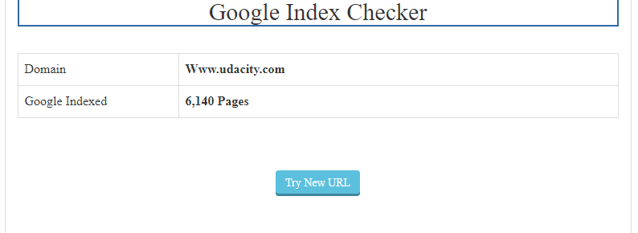
Google index page screenshot

Slide 70
Page Speed
Using the Google Page Speed I found that the speed for Udacity mobile was 34/100 and for desktop was 90/100
Explain why evaluating the Page Speed is important.
Page speed test is important to users because, well, faster pages are more efficient and it provides a much better on-page user experience

Slide 71
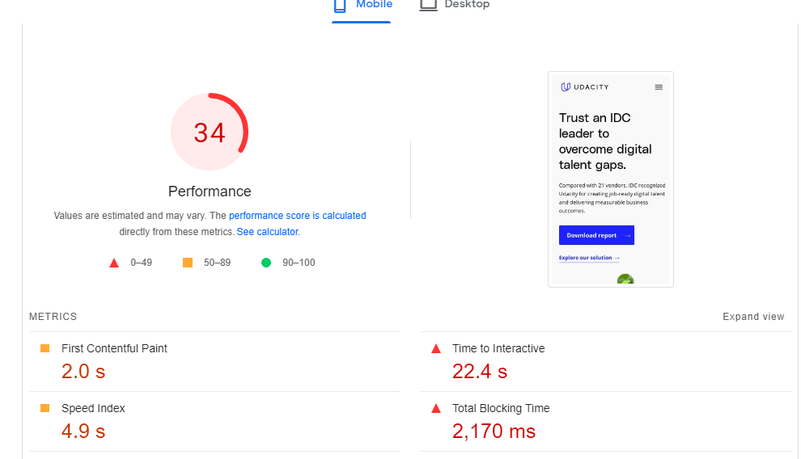
Mobile page speed

Slide 72
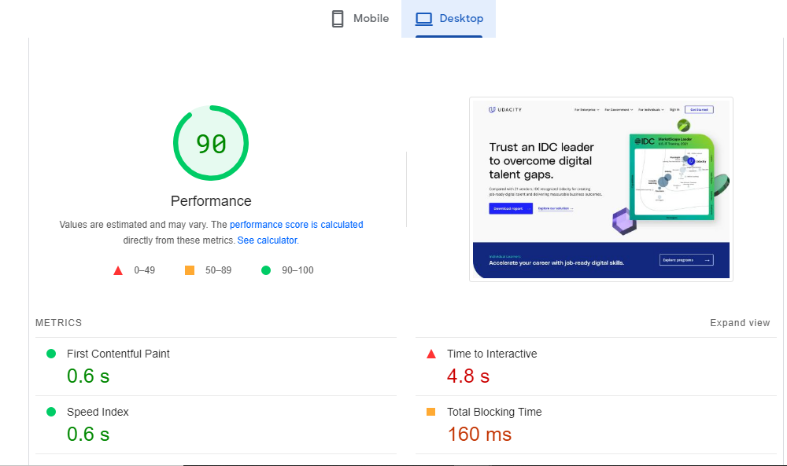
desktop page speed

Slide 73
Mobile-Friendly Evaluation
Using the Think with Google tool I found out that udacity mobile site speed is 2.4 seconds in United States on a 4G connection.
Explain why having a mobile-optimized is Important.
Having a mobile optimized is important because it makes sure to properly display on smaller screens. Also, it makes the site much easier to navigate. It reformats content, displays larger navigation buttons and optimizes images according to screen size.

Slide 74
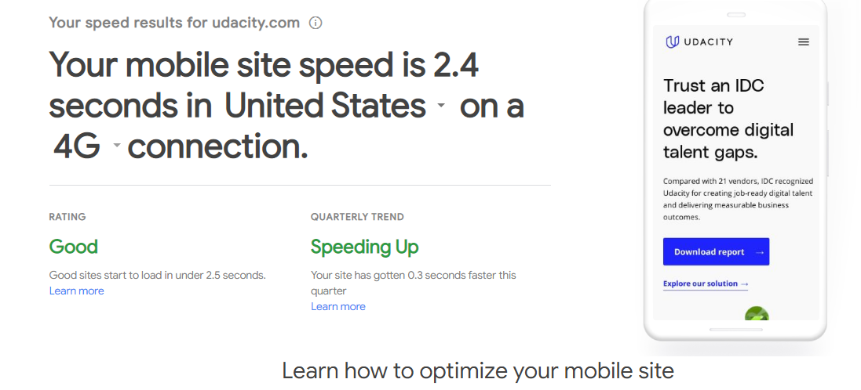
Mobile optimization

Slide 75
Part 5
Recommendations

Slide 76
Recommendations
I experienced slowness in the speed of the mobile version of the Udacity site (34%), as opposed to the desktop speed (90%). This is bad as a lot of persons use mobile devices more when searching he internet. This kind of slowness can affect user’s mobile experience, thereby discouraging the person from waiting till he information he/she needs pops up. Hence, a drastic increase in their bounce back rate. I suggest this be resolved by developers of the Udacity mobile page. The load time should be 0.1seconds. Also, they should set an explicit width and height on image elements to reduce layout shifts and improve CLS, reduced JavaScript execution time and ensure main thread work is minimized.
The 3 websites mentioned for Link building have very high organic traffic, hence, a good platform for advert. We could reach out to them to place a Udacity advert on their pages. Also, we could suggest they make a blogpost about Udacity courses, especially the Digital Marketing Nanodegree, as some of their subscribers could be business owners or in need of a tech skill.
The meta description of the Udacity Digital marketing nanodegree page should be modified to be more descriptive and concise. Blogposts I made can be featured in order to attract more traffic to the site.

Slide 77
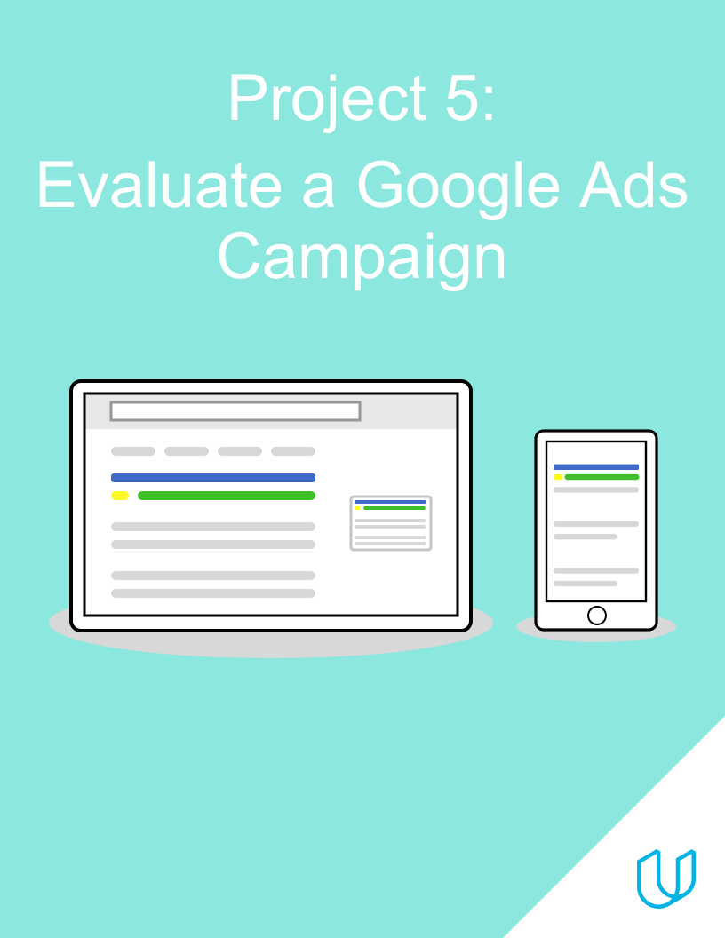
BY: PEACE NGOZI AGHEDO

Slide 78
Campaign Approach
Description and Marketing Objective

Slide 79
1. Campaign Approach
2. Marketing Objective
Udacity has launched a campaign to advertise for the Digital Marketing Nanodegree Program
The campaign is divided into two ad groups, one targeting customers in the Awareness stage and one targeting customers in the Interest stage
Each ad group uses responsive search ads, with multiple options for the ad headline and description
When users click on an ad, they are taken to the overview page for the Digital Marketing Nanodegree Program, where they can click a button to download the program syllabus. This conversion has an estimated value of $5.
The campaign’s marketing objective is to gather at least 200 conversions (syllabus downloads), with a conversion rate of at least 10%

Slide 80
Ad Groups
Ads and Keywords

Slide 81
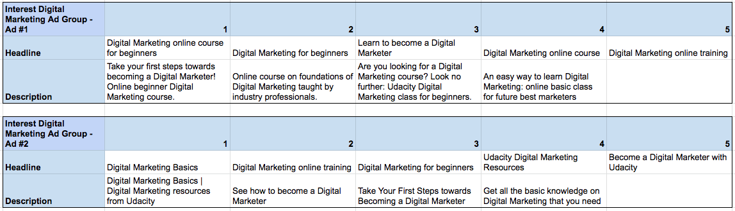
Ad Group #1: Ads
Data is also available in this spreadsheet

Slide 82
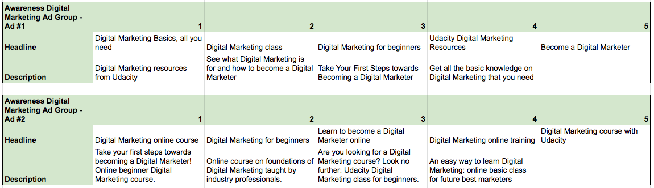
Ad Group #2: Ads
Data is also available in this spreadsheet

Slide 83
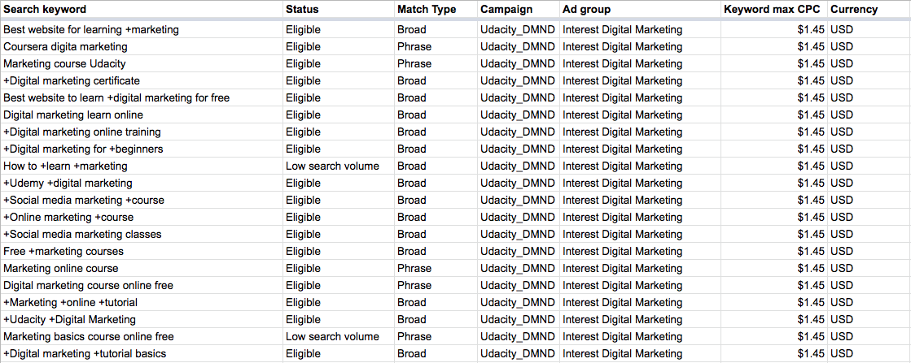
Ad Group #1: Keywords
Data is also available in this spreadsheet

Slide 84
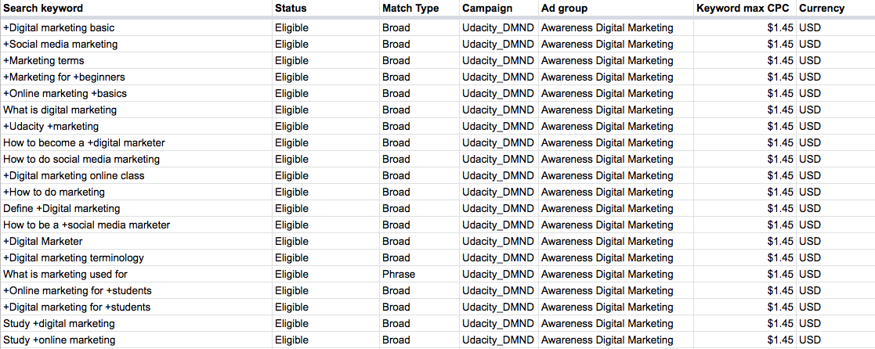
Ad Group #2: Keywords
Data is also available in this spreadsheet

Slide 85
Campaign Evaluation
Results, Analysis and Recommendations

Slide 86
Key Results (Campaign)
Expand the table below to identify and fill in any campaign-level KPIs/metrics you feel will be relevant to your evaluation of the campaign’s performance
Ad Group | Cost | Clicks | Impressions | Conversions | CPC | CTR | C/C | CR
Udacity DMND Campaign | $1,314.00 | 2391 | 111256 | 221 | $0.55 | 2.15% | $5.95 | 9.24%
Campaign data is also available in this spreadsheet
To add columns to your table, right-click where you want to add the column and select either “insert column left” or “insert column right”

Slide 87
Key Results (Ad Groups)
Expand the table below to identify and fill in any ad group-level KPIs/metrics you feel will be relevant to your evaluation of the campaign’s performance
Ad Group | Cost | Clicks | Impressions | Conversions | CPC | CTR | C/C | CR
Ad Group 1: Interest Digital Marketing | $819.05 | 1553 | 72497 | 132 | $0.53 | 2.14% | $6.20 | 8.50%
Ad Group 2: Awareness Digital Marketing | $494.95 | 838 | 38759 | 89 | $0.59 | 2.16% | $5.56 | 10.62%
Total | $1,314.00 | 2391 | 111256 | 221 | $0.55 | 2.15% | $5.95 | 9.24%

Slide 88
Key Results (Ads)
Expand the table below to identify and fill in any ad-level KPIs/metrics you feel will be relevant to your evaluation of the campaign’s performance
Ad | Cost | Clicks | Impressions | Conversions | CPC | CTR | C/C | CR
Ad Group 1, Ad 1 | $458.25 | 991 | 40163 | 97 | $0.46 | 2.47% | $4.72 | 9.79%
Ad Group 1, Ad 2 | $360.80 | 562 | 32334 | 36 | $0.64 | 1.74% | $10.02 | 6.41%
Ad Group 2, Ad 1 | $335.60 | 619 | 28827 | 72 | $0.54 | 2.15% | $4.66 | 11.63%
Ad Group 2, Ad 2 | $159.35 | 219 | 9932 | 16 | $0.73 | 2.20% | $9.96 | 7.31%

Slide 89
Key Results (Keywords)
Search keyword | Status | Match Type | Campaign | Ad group | Keyword max CPC | Currency | Cost | Clicks | Impressions | Conversions | CPC | CTR | C/C | CR
+Online marketing +course | Eligible | Broad | Udacity_DMND | Interest Digital Marketing | $1.45 | USD | $317.10 | 534 | 26639 | 65 | $ 0.59 | 2.00% | $ 4.88 | 12.17%
+Social media marketing +course | Eligible | Broad | Udacity_DMND | Interest Digital Marketing | $1.45 | USD | $36.00 | 66 | 912 | 10 | $ 0.55 | 7.24% | $ 3.60 | 15.15%
+Digital marketing certificate | Eligible | Broad | Udacity_DMND | Interest Digital Marketing | $1.45 | USD | $23.10 | 48 | 894 | 8 | $ 0.48 | 5.37% | $ 3.08 | 15.63%

Slide 90
Campaign Evaluation
Evaluate how successful the campaign was, based on the marketing objective
Feel free to use “bullet points” for your analysis and add as many slides as you need.
Include the following information in your answer (you can also review Lesson 6 in the SEM course for some additional guidance):
The campaign’s return on investment (ROI), including identification of whether the campaign was ROI-positive or ROI-negative
ROI = (total conversion value - total cost)/total cost
Identify and calculate at least three relevant KPIs at the campaign, ad group, ad, and keyword level
Based on your KPI calculations, identify which three keywords performed the best, and explain your reasoning for the ones you selected
Based on your KPI calculations, make an inference about which keywords are subject to higher competition in Google Ads. Explain your reasoning and which KPIs you used to make your hypothesis.
An overview statement of how well or not well the campaign performed relative to its marketing objective, supported with evidence

Slide 91
Campaign Evaluation
ROI = (Total conversion value – Total cost) Total Cost= (221*5 - $1, 1314.00)/$1,1314)= $0.16.
From this calculation, we are able to deduce that the ROI was negative, there was a loss of $0.16.
Relevant KPI for Campaign Level
Cost Per Click (CPC) = Ad cost / number of clicks = $1,314.00/2391 = $0.55
Click Through Rate (CTR)= (Number of clicks / Number of Impressions) x 100% = (2391/111256) x 100% = 2.15%
Cost per Conversion (C/C)= Ad cost / Conversions = $1,314.00/221 = $5.95
Conversion Rate (CR)= (Conversions / Clicks) x 100% = (221/2391) x 100% = 9.24%
Campaign | Cost | Clicks | Impressions | Conversions | CPC | CTR | C/C | CR
Udacity_DMND | $1,314.00 | 2391 | 111256 | 221 | $0.55 | 2.15% | $5.95 | 9.24%

Slide 92
Relevant KPI For Ad group
Campaign | Cost | Clicks | Impressions | Conversions | CPC | CTR | C/C | CR
Ad Group 1: Interest Digital Marketing | $819.05 | 1553 | 72497 | 132 | $0.53 | 2.14% | $6.20 | 8.50%
Ad Group 2: Awareness Digital Marketing | $494.95 | 838 | 38759 | 89 | $0.59 | 2.16% | $5.56 | 10.62%
Total | $1,314.00 | 2391 | 111256 | 221 | $0.55 | 2.15% | $5.95 | 9.24%
Ad group 1 Cost Per Click (CPC) = Ad cost / number of clicks = $819.05/1553 = $0.53 Click Through Rate (CTR)= (Number of clicks / Number of Impressions) x 100% = (1553/72497) x 100% = 2.14% Cost per Conversion (C/C) = Ad cost / Conversions = $819.05/132 = $6.20 Conversion Rate (CR)= (Conversions / Clicks) x 100% = (132/1553) x 100% = 8.50% | Ad group 2 Cost Per Click (CPC) = Ad cost / number of clicks = $494.95/838 = $0.59 Click Through Rate (CTR)= (Number of clicks / Number of Impressions) x 100% = (838/38759) x 100% = 2.16% Cost per Conversion (C/C) = Ad cost / Conversions = $494.95/89 = $5.56 Conversion Rate (CR)= (Conversions / Clicks) x 100% = (89/838) x 100% = 10.62%

Slide 93
Relevant KPI For Ad Level
Campaign | Cost | Clicks | Impressions | Conversions | CPC | CTR | C/C | CR
Ad group 1, Ad 1 | $458.25 | 991 | 40163 | 97 | $0.46 | 2.47% | $4.72 | 9.79%
Ad group 1, Ad 2 | $360.80 | 562 | 32334 | 36 | $0.64 | 1.74% | $10.02 | 6.41%
Ad group 2, Ad 1 | $335.60 | 619 | 28827 | 72 | $0.54 | 2.15% | $4.66 | 11.63%
Ad group 2, Ad 2 | $159.35 | 219 | 9932 | 16 | $0.73 | 2.20% | $9.96 | 7.31%
Ad group 1, Ad 1 Cost Per Click (CPC) = Ad cost / number of clicks = $458.02/991 = $0.46 Click Through Rate (CTR)= (Number of clicks / Number of Impressions) x 100% = (991/40163) x 100% = 2.47% Cost per Conversion (C/C) = Ad cost / Conversions = $458.25/97 = $4.72 Conversion Rate (CR)= (Conversions / Clicks) x 100% = (97/991) x 100% = 9.79% | Ad group 2, Ad 1 Cost Per Click (CPC) = Ad cost / number of clicks = $335.60/619 = $0.54 Click Through Rate (CTR)= (Number of clicks / Number of Impressions) x 100% = (619/28827) x 100% = 2.15% Cost per Conversion (C/C) = Ad cost / Conversions = $335.60/72 = $4.66 Conversion Rate (CR)= (Conversions / Clicks) x 100% = (72/619) x 100% = 11.63%
Ad group 1, Ad 2 Cost Per Click (CPC) = Ad cost / number of clicks = $360.80/562 = $0.64 Click Through Rate (CTR)= (Number of clicks / Number of Impressions) x 100% = (562/32334) x 100% = 1.74% Cost per Conversion (C/C)= Ad cost / Conversions = $360.80/36 = $10.02 Conversion Rate (CR)= (Conversions / Clicks) x 100% = (36/562) x 100% = 6.41% | Ad group 2, Ad 2 Cost Per Click (CPC) = Ad cost / number of clicks = $159.35/219 = $0.73 Click Through Rate (CTR)= (Number of clicks / Number of Impressions) x 100% = (219/9932) x 100% = 2.20% Cost per Conversion (C/C) = Ad cost / Conversions = $159.35/16 = $9.96 Conversion Rate (CR)= (Conversions / Clicks) x 100% = (16/219) x 100% = 7.31%

Slide 94
Relevant KPI For Best Performing Keywords
Keyword one = +Online marketing +course
Cost Per Click (CPC) = Ad cost / number of clicks = $317.10/534 = $0.59 < than keyword max CPC
Click Through Rate (CTR)= (Number of clicks / Number of Impressions) x 100% = (534/26639) x 100% = 2.0% High CTR
Cost per Conversion (C/C)= Ad cost / Conversions = $317.10/65 = $4.88 < estimated conversion value of $5
Conversion Rate (CR)= (Conversions / Clicks) x 100% = (65/534) x 100% = 12.17% > Expected conversion rate of 10%
Keyword | Cost | Clicks | Impressions | Conversions | Keyword max CPC | CPC | CTR | C/C | CR
+Online marketing +course | $317.10 | 534 | 26639 | 65 | 1.45 | $ 0.59 | 2.00% | $ 4.88 | 12.17%
+Social media marketing +course | $36.00 | 66 | 912 | 10 | 1.45 | $ 0.55 | 7.24% | $ 3.60 | 15.15%
+Digital marketing certificate | $23.10 | 48 | 894 | 8 | 1.45 | $ 0.48 | 5.37% | $ 3.08 | 15.63%

Slide 95
Relevant KPI For Best Performing Keywords
Keyword Two: +Social media marketing +course
Cost Per Click (CPC) = Ad cost / number of clicks = $36.00/66 = $0.55 < than keyword max CPC
Click Through Rate (CTR)= (Number of clicks / Number of Impressions) x 100% = (66/912) x 100% = 7.2% High CTR
Cost per Conversion (C/C)= Ad cost / Conversions = $36.00/10 = $3.60 < estimated conversion value of $5
Conversion Rate (CR)= (Conversions / Clicks) x 100% = (10/66) x 100% = 15.15% > Expected conversion rate of 10%
Keyword Three: +Digital marketing certificate
Cost Per Click (CPC) = Ad cost / number of clicks = $23.10/48 = $0.48 < than keyword max CPC
Click Through Rate (CTR)= (Number of clicks / Number of Impressions) x 100% = (48/894) x 100% = 5% High CTR
Cost per Conversion (C/C)= Ad cost / Conversions = $23.10/8 = $3.08 < estimated conversion value of $5
Conversion Rate (CR)= (Conversions / Clicks) x 100% = (8/48) x 100% = 15.63% > Expected conversion rate of 10%

Slide 96
Relevant KPI For Best Performing Keywords
Hypothesis why hey are best performing keywords.
Keyword one = +Online marketing +course
Conversion Rate is 12.17% which is greater than the expected conversion rate of 10%.
Conversion (syllabus download) for this keyword was 66. this is high and plays a huge role in meeting the objective of this campaign to gather at least 200 Conversions (syllabus download).
Cost per Conversion is $4.88 which is lesser than the estimated conversion value of $5
Keyword Two: +Social media marketing +course
Conversion Rate is 15.15% which is greater than the expected conversion rate of 10%
Conversion (syllabus download) for this keyword was 10. this is okay and plays a role in meeting the objective of this campaign to gather at least 200 Conversions (syllabus download).
Cost per Conversion is $3.60 which is lesser than the estimated conversion value of $5
Keyword Three: +Digital marketing certificate
Conversion Rate is 15.63% which is greater than the expected conversion rate of 10%
Conversion (syllabus download) for this keyword was 8. this is okay and plays a role in meeting the objective of this campaign to gather at least 200 Conversions (syllabus download).
Cost per Conversion is $3.08 which is lesser than the estimated conversion value of $5
These 3 best performing keywords also have high competitions judging form their high Cost per click (CPC).

Slide 97
Keyword with Higher Competitions
Search keyword | Ad group | Keyword max CPC | Currency | Cost | Clicks | Impressions | Conversions | CPC | CTR | C/C | CR
+Online marketing +course | Interest Digital Marketing | $1.45 | USD | $317.10 | 534 | 26639 | 65 | $ 0.59 | 2.00% | $ 4.88 | 12.17%
+Social media marketing +course | Interest Digital Marketing | $1.45 | USD | $36.00 | 66 | 912 | 10 | $ 0.55 | 7.24% | $ 3.60 | 15.15%
+Digital marketing certificate | Interest Digital Marketing | $1.45 | USD | $23.10 | 48 | 894 | 8 | $ 0.48 | 5.37% | $ 3.08 | 15.63%
Best website for learning +marketing | Interest Digital Marketing | $1.45 | USD | $9.90 | 24 | 1188 | 3 | $ 0.41 | 2.02% | $ 3.30 | 12.50%
+Digital Marketer | Awareness Digital Marketing | $1.45 | USD | $14.70 | 26 | 2927 | 3 | $ 0.57 | 0.89% | $ 4.90 | 11.54%
+Digital marketing for +students | Awareness Digital Marketing | $1.45 | USD | $6.00 | 13 | 1912 | 2 | $ 0.46 | 0.68% | $ 3.00 | 15.38%
Keywords being bid on by a lot of advertisers are those with higher competition in google ads, hence, they have very high Cost Per Click.

Slide 98
Overview Statement of the Performance of the Campaign
The objective of this Campaign Marketing is to gather at least 200 conversions (syllabus downloads), with a conversion rate of at least 10%.
The campaign had an estimated conversion value of $5.
Result shows that the campaign had a conversion of 221, incurred a cost per conversation value of $5.95 (expected conversion value of $5), and a conversion rate of 9.24% (<expected conversion rate of 10%). Comparing the campaign results with the campaign objectives, the campaign did not perform well. Hence, I can say, the objectives of this campaign were not fulfilled.

Slide 99
Recommendations
Ad group 2 (Awareness Digital Marketing) performed far better than ad group one; it had a higher CTR of 2.16% and CR of 10.62%, hence I would allocate more budget to it, as it stands in the position of bringing more traffic to the Udacity website.
Since Ad group 1 (Interest Digital Marketing) did not yield much result, I would optimize Ad group 1 in order to achieve the campaign objectives. To optimize this campaign, I will create another Ad Variation to match against Ad group 1, by modifying the picture attached or the heading to “Complete Guide to Digital Marketing”.
In order to ascertain the major reason why Ad group 2 was more productive, maybe as a result of the Ad description. I will set up an A/B test on Ad group 2. results from this test will be effected ino improving Ad group 1.

Slide 100

BY: PEACE NGOZI AGHEDO

Slide 101
Assumptions
Marketing Objective: You are running an advertising campaign with the goal of signing up students for the Digital Marketing Nanodegree
Cost: The cost of the degree is $999
Profit: For the purpose of this assignment, assume a profit margin of 30%, meaning that Udacity makes $299 in profit per student that signs up.
Campaign: We want to aggressively grow the program, but, we want to do it without losing money.

Slide 102
Formulas:
Conversion Assumption: 0.2% Conversion via Landing page
Calculating #of Sign Ups: Clicks to the landing page *0.002 = # of Student Sign Ups
Note: Please round to the nearest whole number
CPA: Cost of Campaign/# sign ups = CPA
Note: Please round to the nearest cent
ROI: [(299 Profit) - CPA] * # of Student Sign Ups = ROI

Slide 103
Part 1
Evaluate a Display Image Campaign

Slide 104
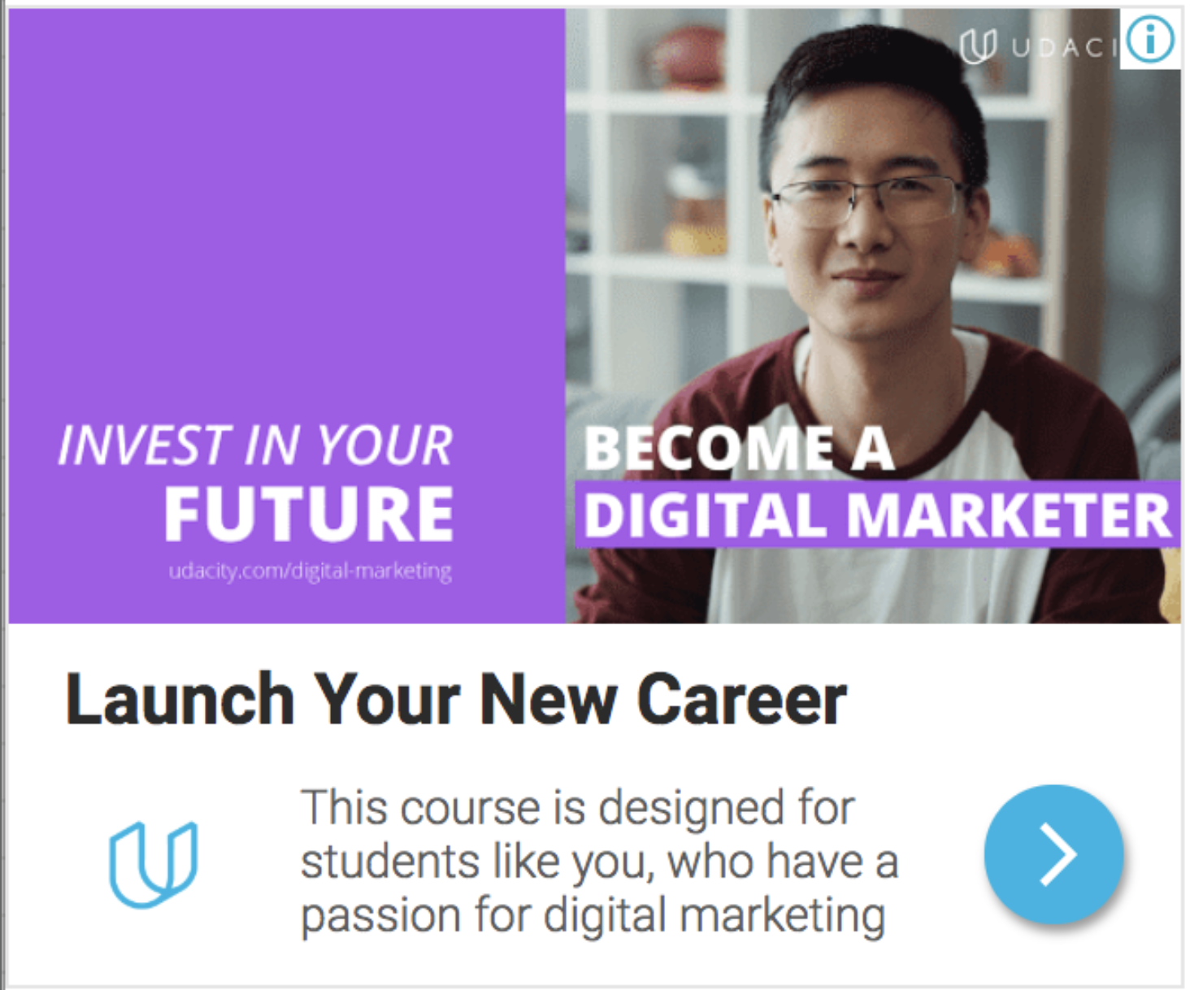
Display Image Campaign: Overall Results
Find below the overall results of the Display Image Campaign targeting the Affinity Audience. The Affinity Audience consisted of Business Professionals Social Media Enthusiasts.

Slide 105
Results:
Calculate the ROI
What was the overall ROI of the campaign? Was it Positive or Negative?
The overall ROI of the campaign was +$149.04 hence the campaign was positive.
Creative | Clicks | Impressions | CTR | Avg CPC
Campaign Results | 1,243 | 200,957 | 0.62% | $0.36
Cost | Conversion Rate | # New Students | CPA | ROI +/-
$448.95 | 0.2% | 2 | $224.48 | +149.04

Slide 106
How would you optimize this campaign?
Suggestion 1: I’ll suggest A/B testing be conducted to ascertain if a change in the display picture added to the campaign will positively affect the campaign’s performance by attracting the interest of more audience, thereby increasing the traffic to the site.
Suggestion 2: I’ll suggest a change in the Ad target audience. The target audience used initially should be expanded to reach more persons of different age groups, races and background.
Suggestion 3: I’ll also suggest a change of the Ad Headline. The headline should be structured in respect of the target audiences so they can easily relate to the topic when they see it. The headline can be rephrased to “Acquire in-Demand Business tech Skills”. This will interest Business professionals who are social media enthusiasts.

Slide 107
Part 2
Evaluate a Display Image Campaign

Slide 108
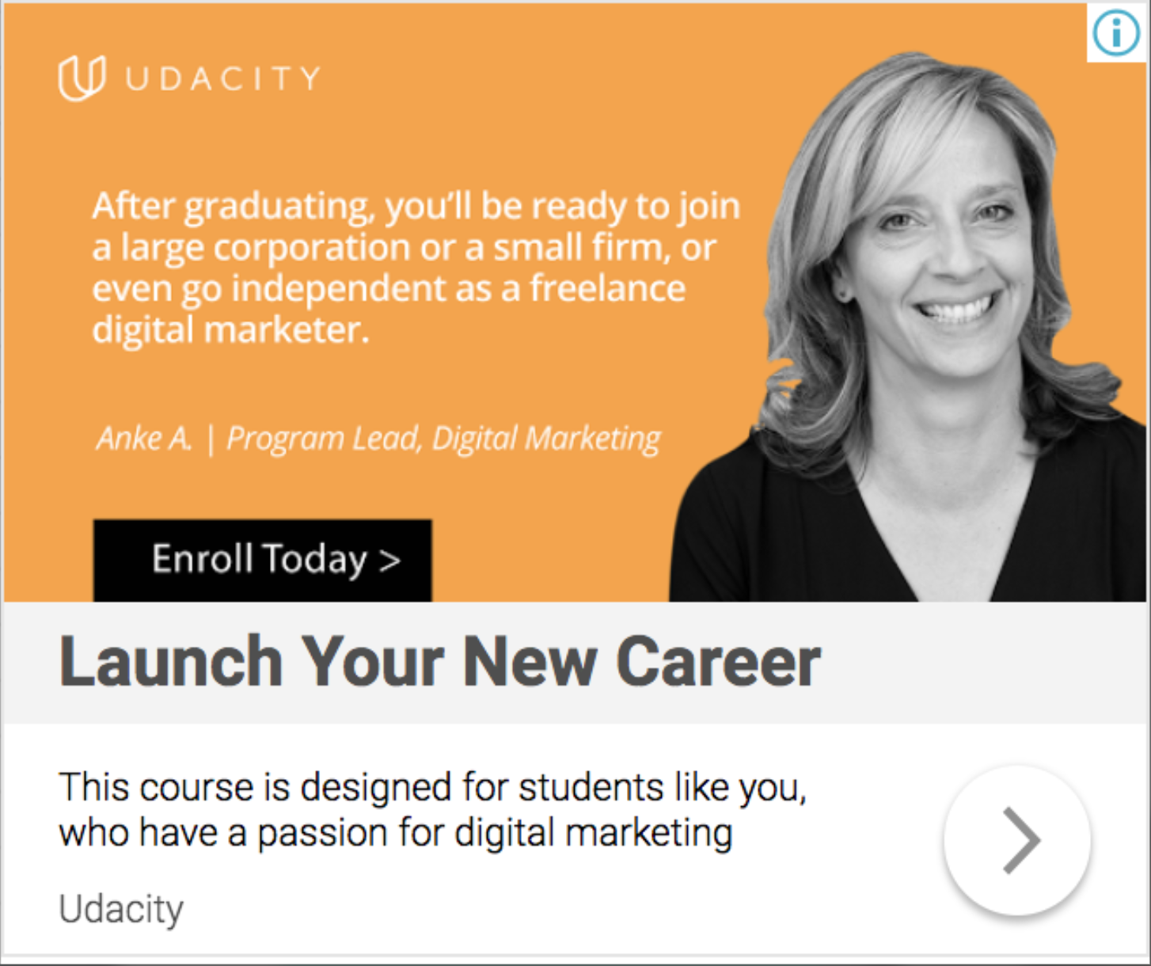
Display Image Campaign: Site Targeting Find below the overall results of the Display Image Campaign targeting placements (site targeting). This audience consists of the Digital Marketing partners’ landing pages.

Slide 109
Results: Calculate the ROI
What was the overall ROI of the campaign? Was it Positive or Negative?
The overall ROI of the campaign was +$67.01. hence the campaign was positive.
Creative | Clicks | Impressions | CTR | Avg CPC
Campaign Results | 407 | 67,833 | 0.6% | $0.57
Cost | Conversion Rate | # New Students | CPA | ROI +/-
$231.99 | 0.2% | 1 | $231.99 | +$67.01

Slide 110
How would you optimize this campaign?
Suggestion 1: I’ll suggest a change in the Ad target audience. The target audience used initially should be expanded to reach more persons of different age groups, races and background.
Suggestion 2: I’ll suggest A/B testing be conducted to ascertain if a change in the display picture added to the campaign will positively affect the campaign’s performance by attracting the interest of more audience, thereby increasing the traffic to the site. I suggest the picture of both a younger and older person be added to show that it is not for only the old but for all age group.
Suggestion 3: I’ll also suggest a change of the Ad Headline. The headline should be structured in respect of the target audiences so they can easily relate to the topic when they see it. The headline can be rephrased to “Launch a New Career in Digital Marketing”. This will interest Business professionals who are social media enthusiasts.

Slide 111
Part 3
Evaluate a Display Image Campaign

Slide 112
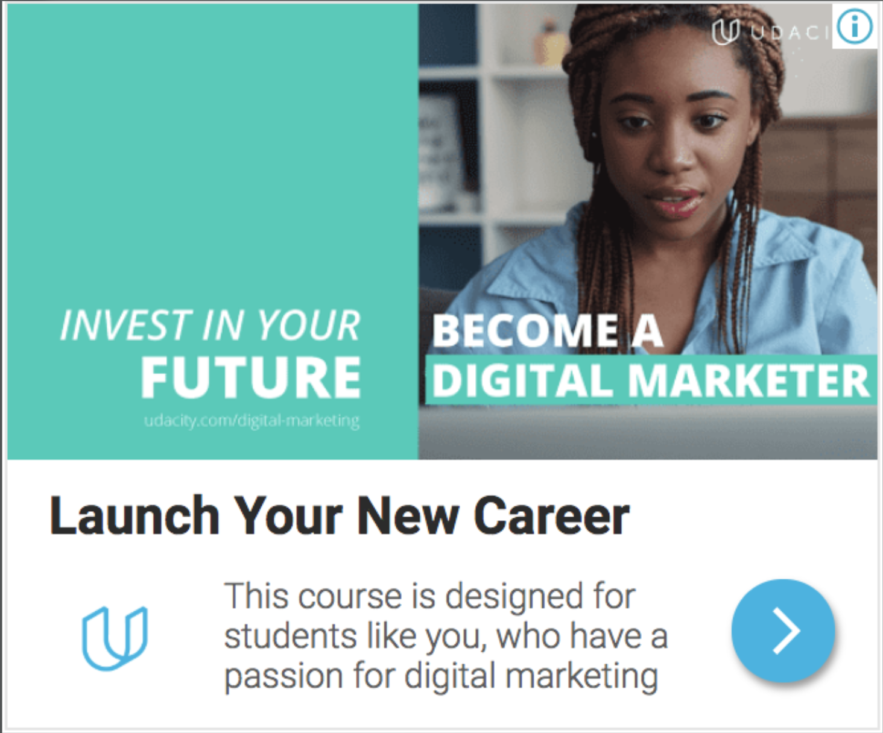
Display Image Campaign: Overall Results
Review below the overall results of the Display Image Campaign targeting visitors to the Digital Marketing Nanodegree Program landing page

Slide 113
Results: Calculate the ROI
What was the overall ROI of the campaign? Was it Positive or Negative?
The overall ROI of the campaign was +$64.5. hence the campaign was positive.
Creative | Clicks | Impressions | CTR | Avg CPC
Campaign Results | 670 | 109,994 | 0.61% | $0.35
Cost | Conversion Rate | # New Students | CPA | ROI +/-
$234.50 | 0.2% | 1 | $234.50 | +$64.5

Slide 114
How would you optimize this campaign?
Suggestion 1: I’ll also suggest a change of the Ad Headline. The headline should be structured in respect of the target audiences so they can easily relate to the topic when they see it. The headline can be rephrased to “Gain a Degree in Digital Marketing”. This will interest Business professionals who are social media enthusiasts.
Suggestion 2: I’ll suggest a change in the Ad target audience. The target audience used initially should be expanded to reach more persons of different age groups, races and background.
Suggestion 3:I’ll suggest A/B testing be conducted to ascertain if a change in the display picture added to the campaign will positively affect the campaign’s performance by attracting the interest of more audience, thereby increasing the traffic to the site.

Slide 115
Part 4
Results, Analysis, and Recommendations

Slide 116
Which campaign performed the best? Why?
Amongst all three campaign, the best performing campaign was Campaign 1 -Affinity Audience). This is based on the fact that It had the highest number of landing site clicks of 1247 compared to campaigns two and three that had 407 and 670 respectively.
Also, Campaign 1 yields more profit to Udacity since it had the highest number of signup students- 2 (2x299=$598) compared to the other two campaigns that had just 1 signup student each, hence a lower profit ($299).
Also, the ROI for campaign 1 was positive and very high (+$149.05) compared to campaigns two and three that had +$67.01 and +$64.5 respectively.

Slide 117
Recommendations for future campaigns
I’ll suggest A/B testing be conducted to ascertain if a change in the display picture added to the campaign will positively affect the campaign’s performance by attracting the interest of more audience, thereby increasing the traffic to the site. Instead of using the picture of an old woman, I suggest the pictures of both a younger and older person of different gender be added to show that it is not for only the old and one gender but for all age group and all gender.
I’ll suggest a Call-to-action button named “Register now” be added to the campaign to carry interested people to the landing site.
I suggest that more focus be put on Ad Campaign One – (Affinity Audience) due to It’s high performance. The budget should be increased since it shows more prospect of achieving the campaign’s objective.

Slide 118
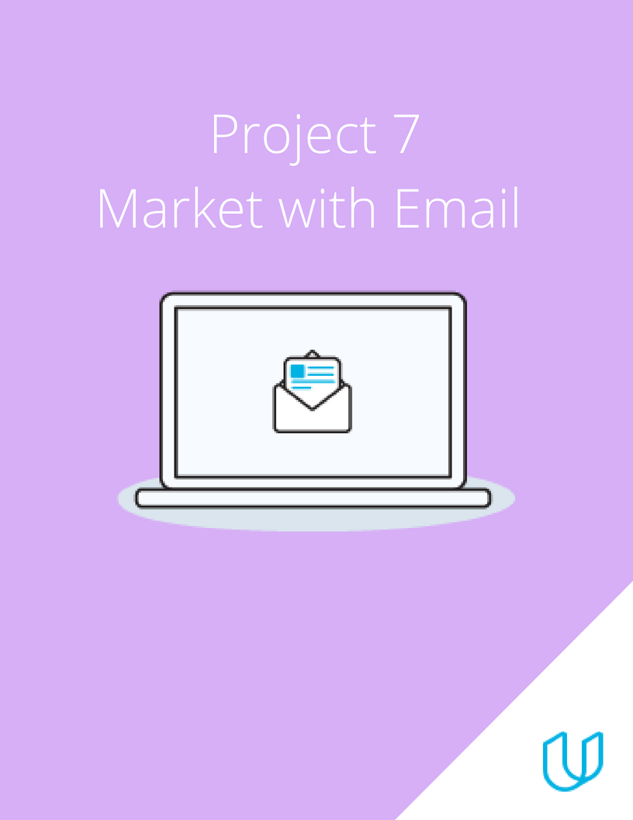
Project 7: Email Marketing
BY PEACE NGOZI AGHEDO

Slide 119
Part 1
Plan Your Email Campaign

Slide 120
Marketing Objective & KPI
Marketing Objective - To get 40 new students to enroll for the Udacity DMND course through 3 email campaign between May 23rd and June 10^{th.}
KPI - Conversion Rate

Slide 121
Target Persona
Background and Demographics | Target Persona Name | Needs
AGE: 40 GENDER: Male MARITAL STATUS: Married NUMBER OF CHILDREN: 3 COUNTRY: Nigeria STATE OF RESIDENCE: Edo EMPLOYED: Yes ANNUAL INCOME: 1 million naira HIGHEST CERTIFICATION: Masters Degree | MATTHEW | Sufficient internet network. Projects to practice Digital Marketing. Better work and better cash inflow. Tutorial videos
Hobbies | Goals | Barriers
Play FIFA PES Travel Singing Dancing Chess | A better job Does not see self in this same industry in the next 3 years. Sees self as a high profiled Digital Marketer in the next 3 years. | High cost of data poor Internet Financial constraints Too many responsibilities at work.

Slide 122
Email Series
Email 1: Launch your new Digital Marketing Career with Udacity.
Email 2: Susan’s Career Switch Story
Email 3: Enrol now!
Registeration into the Udacity digital marketing nanodegree closes June 10th.

Slide 123
Part 2
Create Your Email Campaign

Slide 124
Content Plan: Email 1
Overarching Theme: 3-5 Sentences
General | This email is intended to create awareness on the Udacity digital marketing program by providing relevant information. The objective is to encourage subscribers who have been nurturing the thought of acquiring digital marketing skill to engage the mail by signing up for the program.
Subject Line 1 | Master required skills for a successful Digital Marketing Career
Subject Line 2 (for A/B testing) | Begin your Digital Marketing Journey from the comfort of your home
Preview Text | Join our Digital Marketing Nanodegree Program
Body | Udacity Digital Marketing Nanodegree Program This program is built in partnership with industry pioneers like HubSpot, google, Moz, amongst others. It entails relevant knowledge you need to explore the full range of digital marketing specialties and a broad foundation for digital marketing expertise. In the course of this program, you stand to benefit; mastering the use of social media to scale up your business develop and run real-world campaigns get a 360-degree understanding of digital marketing, etc. With Udacity, learning is interactive and at your pace and convenience. Also, you are guaranteed an effective digital marketing skill that will be beneficial to you and your brand. Globally, over 6000 professionals have enrolled and benefitted from the course. Join this community and supercharge your career.
Outro CTA 1 | Learn more
Outro CTA 2 (for A/B testing) | Read more

Slide 125
Content Plan: Email 2
Overarching Theme: 3-5 Sentences
General | This email is intended to build the interest of subscribers in the Udacity digital marketing program to subscribers. The objective is to make subscribers engage the mail and to consider the program
Subject Line 1 | From Store Keeper to Digital marketer
Subject Line 2 (for A/B testing) | Freelancer: Susan’s success story
Preview Text | Success with Udacity
Body | Hi there, allow me introduce you to Susan. Susan is a 25years old young lady. She is a graduate of the South California business school where she finished the top of the class. After graduation she got job as a store keeper in a shopping mall, but her salary could rarely help pay for her upkeep. One day she stumbles upon the Udacity Digital Marketing Nanodegree ad campaign on her mailbox and enrolled. Despite her tight schedule she finished the classes and did all her projects and graduated. Today, Susan is not just a certified Digital Marketer, an employee of Google, where she is the Team Lead of the Marketing department. Susan’s story can be your story. You too can become digital marketer and get employed by a multi-million company. Sign up today for the Udacity Digital Marketing Nanodegree and join the train to success.
Outro CTA 1 | Read more
Outro CTA 2 (for A/B testing) | Learn more

Slide 126
Content Plan: Email 3
Overarching Theme: 3-5 Sentences
General | The objective is conversion. This email is targeted at subscriber’s, reminding them of the registration deadline and convincing them to sign up before June 10th.
Subject Line 1 | Become a certified Digital Marketer (Last Day). Enroll now!
Subject Line 2 (for A/B testing) | Wait no more! Enroll now for the Udacity Digital Marketing Nanodegree
Preview Text | Final call! Deadline of Udacity Digital Marketing Nanodegree registration.
Body | Hey there, I see you are yet to register for the Udacity Digital Marketing Nanodegree Program. Are you having second doubts about the program? Opportunities like this don’t come around every day. Don’t miss his golden opportunity to be part of something great. Enroll now and don’t miss your chance to become a world class Digital Marketer. Registration closes 11:59pm June 10th and classes begins June 30^{th.} See you soon!
Outro CTA 1 | Enroll now
Outro CTA 2 (for A/B testing) | Sign up now

Slide 127
A/B Test Overview
2 components of my email were created (email #1 and email #2), alongside 2 Subject line (subject line 1&2) and 2 CTA (Outro CTA 1 and Outro CTA 2. I divided my mail list into 2 groups of equal halves- group A and group B.
The steps I will follow:
First, I will test for the subject line
To group A, I will send email #1 with subject line 1 “Master required skills for a successful Digital Marketing Career” and Outro CTA 1 “Learn more”.
To group B, I will send email #2 with subject line 2 “Begin your Digital Marketing Journey from the comfort of your home” and Outro CTA 2 “Read more”.
I will analyze the click rate and CTA to see which performed better and stick to the higher performing subject line. This will be the mail I will send to my full mail list.
A/B testing is important because it helps one understand which email version performs better. It helps understand what keywords can increase the click rate of the email. Also, it helps achieve a higher CTA for a campaign.

Slide 128
Calendar & Plan
Email Name | Planning Phase | Testing Phase | Send Phase | Analyze Phase
Email 1 | May 23rd - 24th | May 25th | May 26th | May 30th – 31st
Email 2 | May 25th - 26th | May 27th | May 30th | June 1st – 2nd
Email 3 | June 1st – 2nd | June 3rd | June 6th | June 8th – 10th
Week One |  |  |  |  | Week Two |  |  |  |  | Week Three
M | T | W | T | F | M | T | W | T | F | M | T | W | T | F
23 | 24 | 25 | 26 | 27 | 30 | 31 | 1 | 2 | 3 | 6 | 7 | 8 | 9 | 10
Email 1
Email 2
Email 3
Color Key | Planning Phase | Testing | Send Phase | Analyze Phase

Slide 129
Part 3
Build & Send

Slide 130
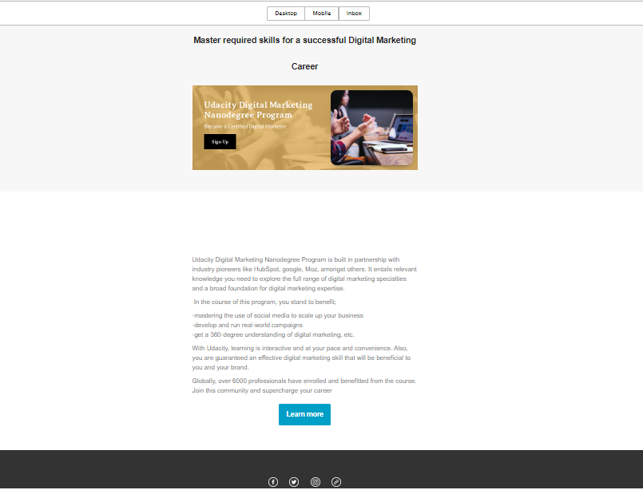
Draft Email

Slide 131
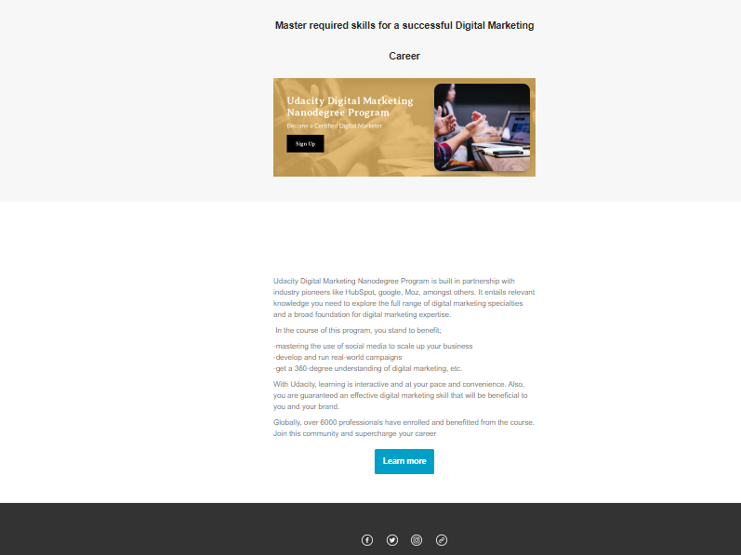
Final Email

Slide 132
Part 4
Sending & Analyzing Results

Slide 133
Results Email #1
After you have hit send on the first email of your campaign, you can spend some time analyzing the results.
Calculate the Open Rate
Results and Analysis
Sent | Delivered | Opened | Opened Rate | Bounced
2500 | 2250 | 495 | 22% | 225

Slide 134
Results Continued Email #1
Results can be monitored within the first 24 hours of an email send, after a couple days or even after a week.
Calculate the CTR and the Conversion Rate
Results and Analysis
Clicked | CTR | Take Action | Conversion | Unsub
180 | 8.0% | 75 | 3.3% | 30

Slide 135
Final Recommendations
If a subscriber unsubscribes from my list, I would make sure to remove the person and other inactive subscribers from my email list. There is no need keeping persons who do not open promotional emails sent. This will help save cost and avoid being blacklisted.
Ill suggest that experiment be done with different visuals (especially email 2). I will attach a short video of Susan telling her story. The words should be condensed more Read and understand the survey results. Feedback should be treated seriously and urgently.
I’ll suggest the results of previous email campaign be analyzed by; tracking the reach of both email #1 and email #2, track Click and Open rates(to understand how subscribers engage with the campaign, so that I can restructure the message), Track unsubscribe rate (to ensure there is nothing discouraging in it) and finally, track number of bounces(to help scrutinize my email list and remove any inactive or invalid email address.

